Slide 1
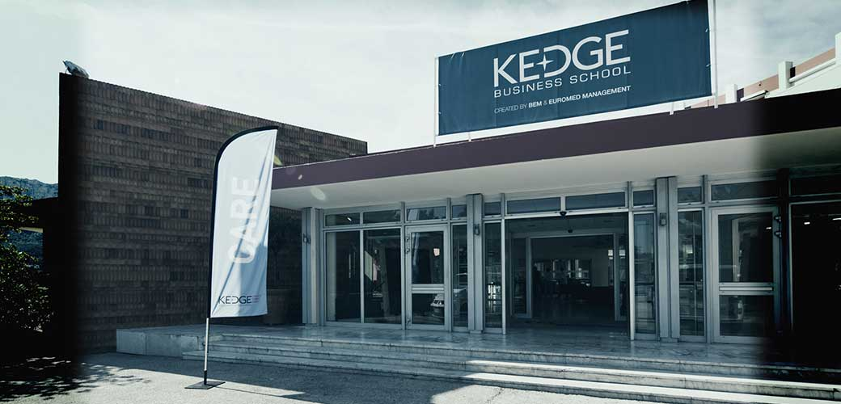
KEDGE Double Degree Program

Slide 2
KEDGE Double Degree Program
First Year at NSYSU 2 Mandatory Courses
3 Fundamental Courses
5 Core Courses
1 Elective course
1Thesis Course
Second Year at KBS
3 Fundamental Courses
6 Elective Courses
A ProACT Group Project
Requirement: Must be IBMBA students; According to KEDGE Business School, students must be less than 28 years old on the first day they enter the KBS.
Quota: 5/ per year
Language Requirement: TOEFL iBT 79/ IELTS 6
Application Period: November 1st, 2017-December 1st, 2017
* You can also refer to the handbook to know more about the course
selection

Slide 3
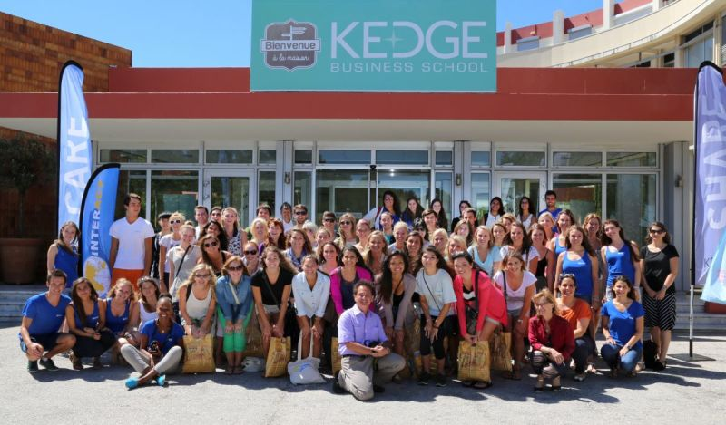
KEDGE Double Degree
Complete two semesters in France; 3 Fundamental Courses to be taken (15ECTS) and 6 in-class elective management (30 ECTS) classes at KEDGE BS to be chosen by the students
Master’s thesis in English
6 months Internship

Slide 4
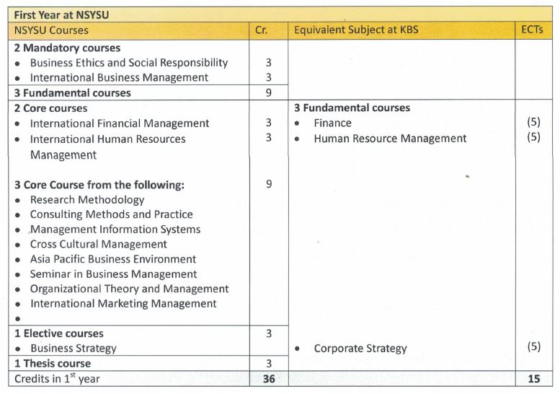
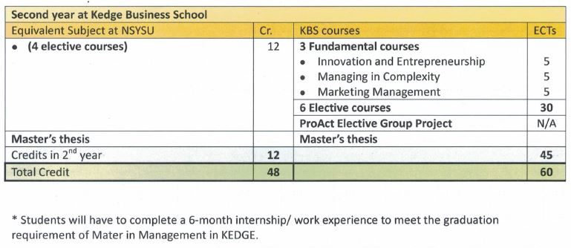
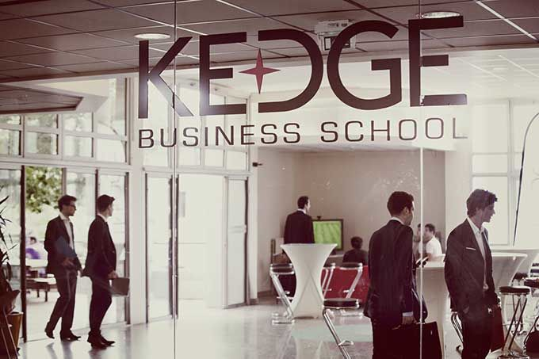
Suggestions toward Course Selection

Slide 5
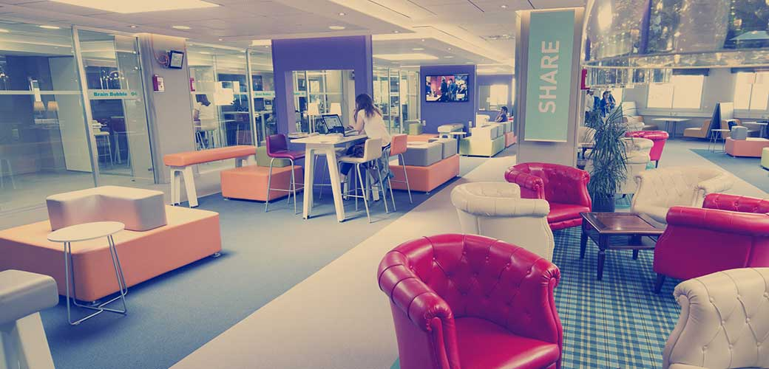
Fee Schedule
Tuition: Registration fee to NSYSU for 2 semesters;
No tuition fees for KEDGE Business School
Credit Fee: Number of Credits shown on the transcript X Credit Fee of IBMBA
Participating students should take care of their own travel and living expenses.

